Slide 1


HS2 Enabling Works – Programme and Project Controls Design for Lean CMO and Clear Information for Decision Making Maximising Productivity and Commercial Recovery, Minimising Risk, Delighting the Client, Leaving a Legacy

Slide 2
Agenda
Introduction to LogiKal
What we were tasked
What was achieved
Pre contract award opportunities
Potential improvements for MCW bids

Slide 3
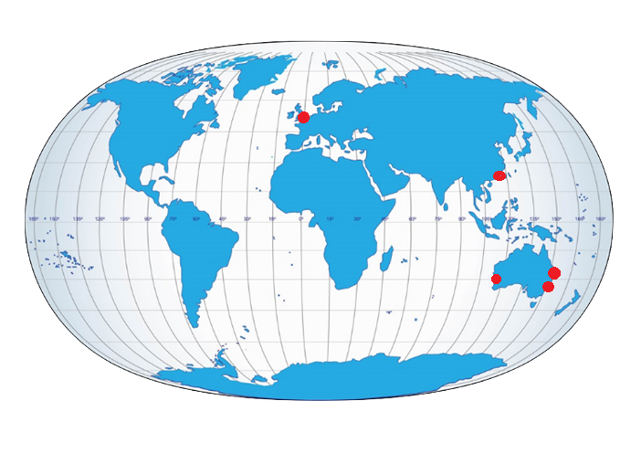
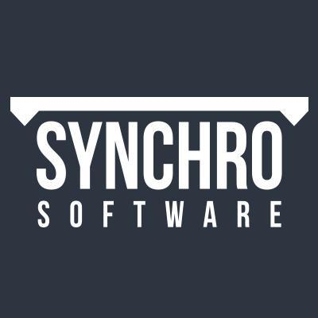




LogiKal Projects – Performance Management Specialist
Overview
Global Reach
Established in 2002
90 consultants worldwide
Dedicated to excellence in performance management through the application of project controls.
Offices in UK, Hong Kong, Perth, Sydney & Brisbane.
Projects covered globally
Consultants available in every time zone
LogiKal Partners

Slide 4
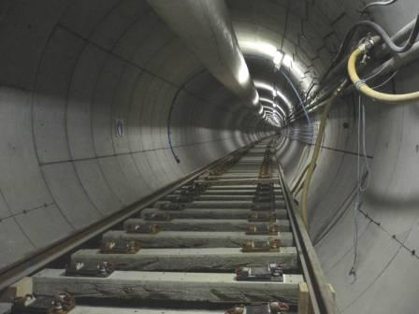
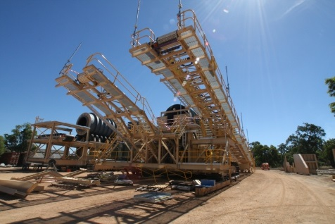
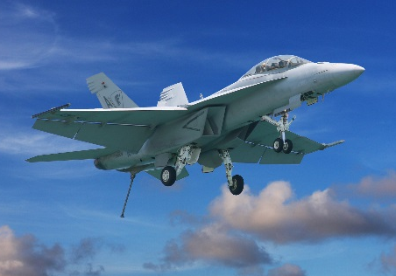



Who are LogiKal Projects?
Supporting clients with the establishment and delivery of world class project performance management
Supporting overall client solutions through the 3 pillars of – People, Process & Systems
Working with major client, contractor and consulting organisations.
Working across a range of industries (rail, oil and gas, roads, power, utilities, airports, mining, water and defence).

Slide 5




LogiKal Projects – Our Services
Transitional & Operational
Planning Services
Cost Engineering
Risk Management
Change Management
Consulting Services
Maturity Assessments
Capability Development
PMO Design and Set Up
Gateway Assurance
BIM for Project Controls
Technology Solutions
Integrated Project controls Architecture
Data Analytics and Dashboard Reporting
Solution design installation and configuration
Training Solutions
Principals of Planning
Risk Management
EVM
Software Training
RIB Csuite and iTWO

Slide 6
What we were tasked to achieve?
The initial request to LogiKal was to support Fusion in responding to questions related to:
Programme Management,
Risk Management and
Cost management.
Scope expanded for the North section to include contribution to other questions related to
cost modelling and
resource profiling and levelling at summary level

Slide 7

Process Flow - Design
Work Package Planning
Update Forecast
Smooth
Demand
Benchmark and Workshop
Assess Risk and
Opportunity
Assess Productivity
And Earned Value
Work Package Quote and PMB update
Record
Cost
Record Change and Update PMB
Record
Physical Progress
Record
Hours and Plant
Used

Slide 8
Project Controls Systems Architecture
Prism
Primavera+ Acumen Fuse
SAP/Sapphire
CEMAR/Xactium
CostOS
Contract Admin
Client Systems
Reporting/Analytics
Qlikview
Monthly Reports Data Quality Analysis Performance Trending Client Reporting
VISUALISE
NEC3 Contract Management
CEMAR
NEC3 Communication
PMB impacts
EWs / Compensation Events
Risk
PRA
@Risk
Xactium
Planning
Primavera
Tilos
Synchro
Acumen Fuse
Financials
Coins
Actual Costs
Accruals
SUMMARISE
MODEL
Cost/Resource Modelling and Control
iTWO
Work Packages Development
Cost Estimate
Resource/Activity schedule
Earned Value Analysis
Budget Forecast
Resource Forecast
Data Validation
ASSURE
Supply chain data capture
Mobile Application
3D visualisation Progress / Quantities installed
CAPTURE

Slide 9
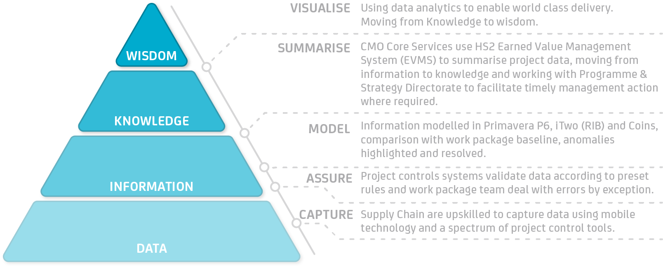
Exploiting Data

Slide 10
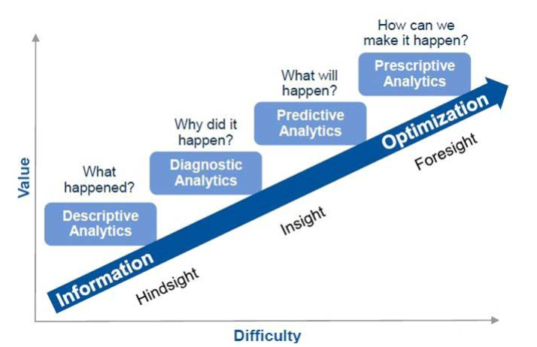
Exploiting Data

Slide 11
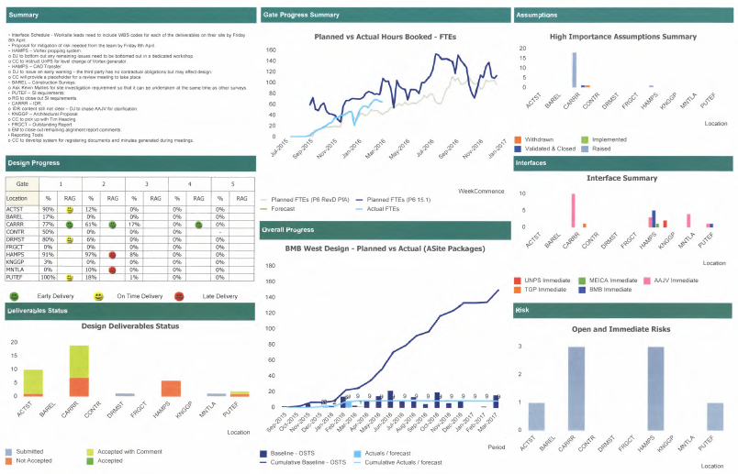
Systems – Analytics, QlikView
QlikView is an effective data analytics and visualisation tool.
LogiKal has extensive experience in using the tools to integrate to Project Controls software such as Primavera, Cobra, iTwo
It provides an interactive reporting system with control on the level of details
It can be easily customised to produce required reports while minimising data handling
Reduces the time of reports production and allow more time for resolving issues.
Data Source
Narrative Register
Data Source
iTwo
Data Source
Interface Register
Data Source
Design Register
Data Source
Primavera
Data Source
Document Management System
Data Source
Xactium

Slide 12
Programme Management Requirements Matrix
Complexity | High Complex (many suppliers, highly constrained) | Integrated P6 Schedule with 4D Simulation/or 14 point DCMA check | Integrated P6 Schedule with 4D Simulation/14 point DCMA with Qualitative Risk Assessment | Integrated P6 Schedule with Quantitative Schedule Risk Analysis (QSRA), and 4D Simulation/14 point DCMA
 | Moderate (single supplier) | Logically Linked Schedule (e.g. P6, MSP, Power Project) | Logically linked Schedule and Qualitative Risk Assessment/14 point DCMA | Logically linked Schedule with QSRA
 | Low Complexity (simple quantity based delivery – low constraint) | Simple Bar Chart (e.g. Excel) | PERT Analysis (e.g. excel with 3 point duration) | Excel based schedule with Simulation schedule (e.g. @Risk)
 |  | Low Uncertainty | Moderate Uncertainty | High Uncertainty
 |  | Uncertainty

Slide 13
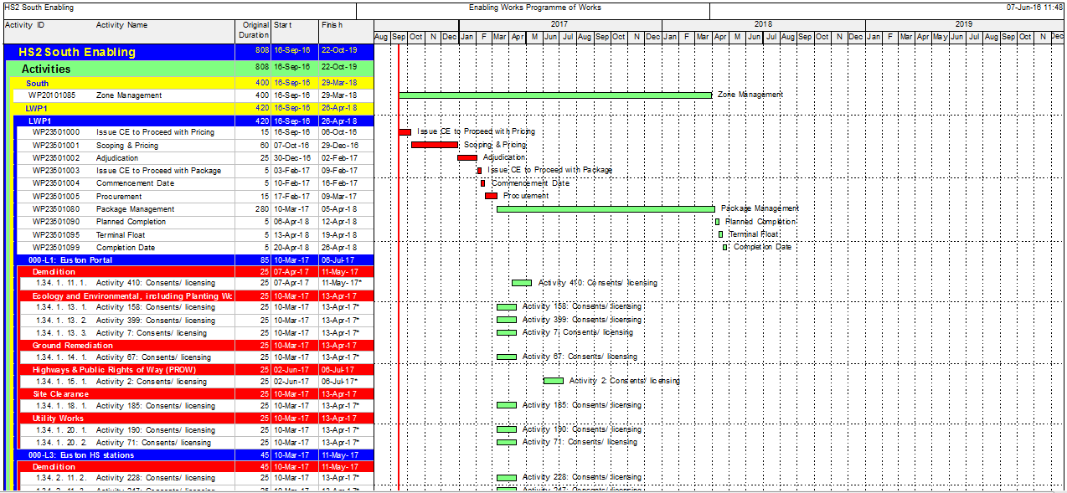
Systems – Scheduling, Primavera
Primavera
Is the leader in CPM scheduling internationally
It has good functionalities in integrating cost and resources with schedules to produce time phased information.
P6 infrastructure allows integration with QlikView and other Cost and EVM software

Slide 14
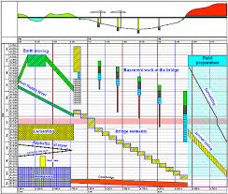
Systems – Scheduling, Tilos
Tilos
It is the leading tool for linear scheduling to produce Time-Chainage Charts.
It is very useful to schedule and graphically present schedule information
It integrates with primavera and other major scheduling software
Very powerful tool for what-if scenario analysis

Slide 15
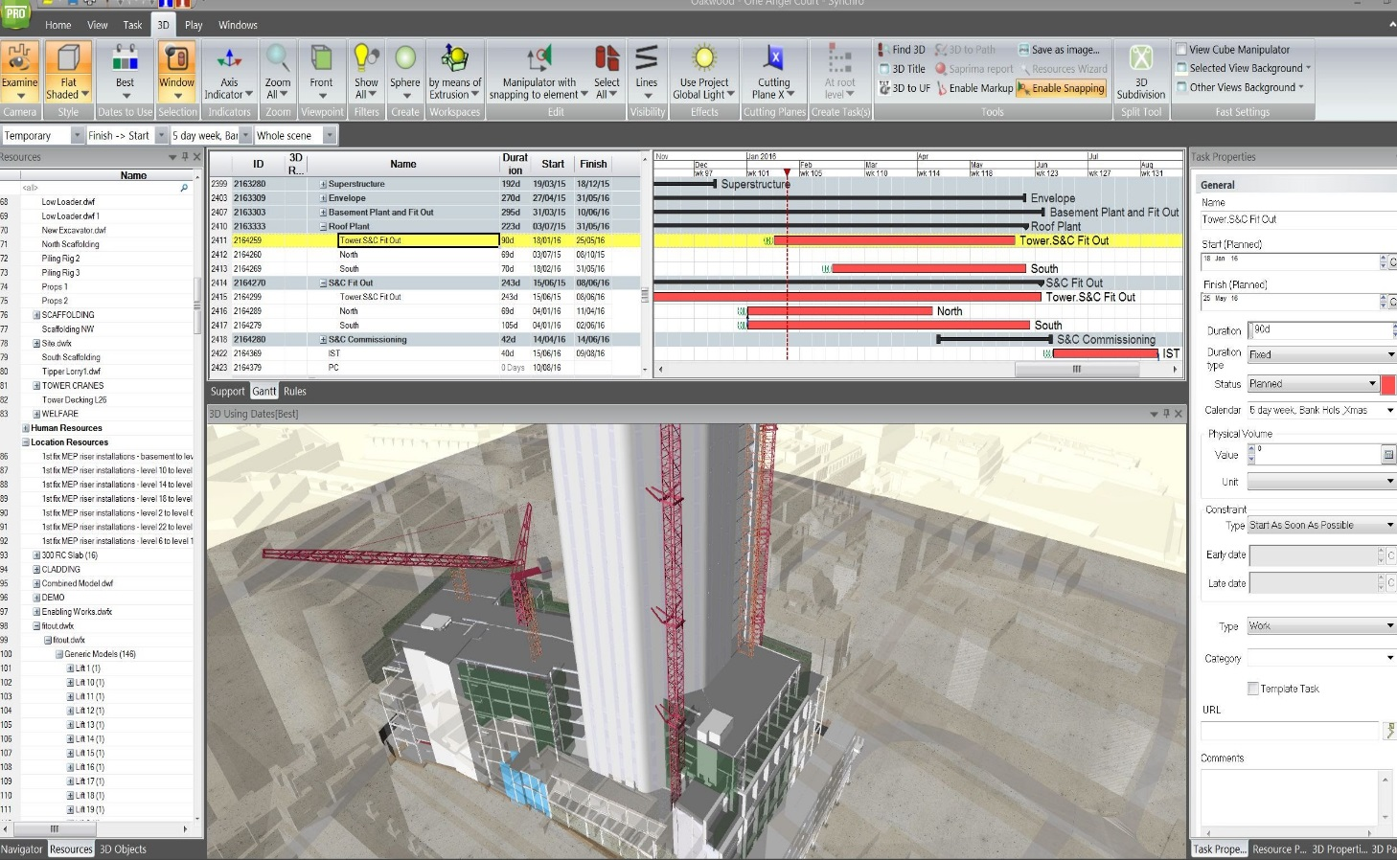
Systems – Scheduling, Synchro
Synchro is very powerful 4D simulation software.
It integrates with major scheduling software packages
Integrates with major 3D modelling software
Allow multiple baselines comparison to current progress
Has an efficient what-if scenarios capabilities.

Slide 16
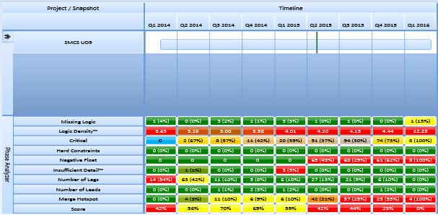
Systems – Scheduling, Acumen Fuse
Acumen Fuse is a schedule health check software. It identify flaws in schedules that may affect CPM calculations.
HS2 specified a minimum score for schedule health check of at least 75%.
Easy to use software and very efficient in identifying schedules issues and resolving them.

Slide 17
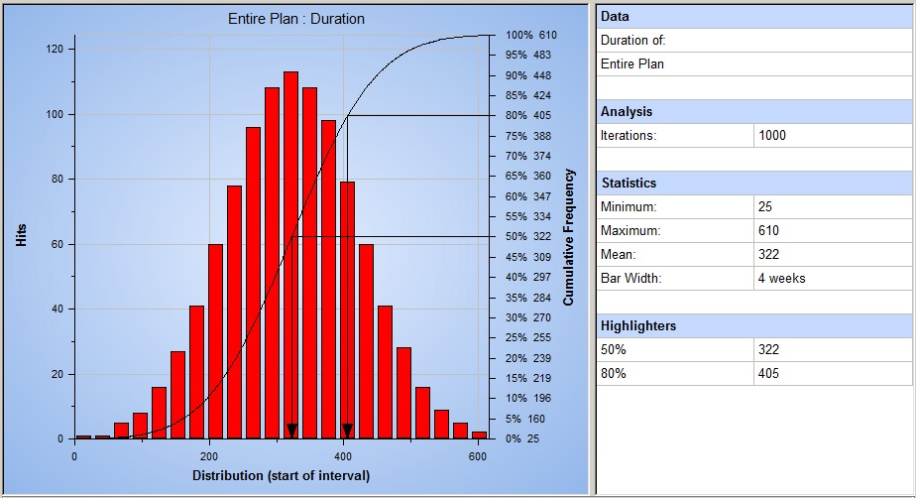
Systems – Risk, Primavera Risk Analysis
Quantitative Risk Analysis software
Performs Monte Carlo simulation to model both Risks and Uncertainties.
Fully compliant with Primavera P6
Produces clear outputs

Slide 18
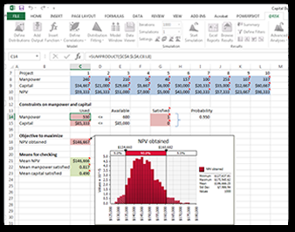
Systems – Risk, @Risk
@Risk is a spreadsheet based risk analysis software.
It is easy to use, however, is not as powerful as PRA.
The system does Monte Carlo simulation but it lakes some functionalities the relates to schedule relationships, and other advance PRA options.

Slide 19
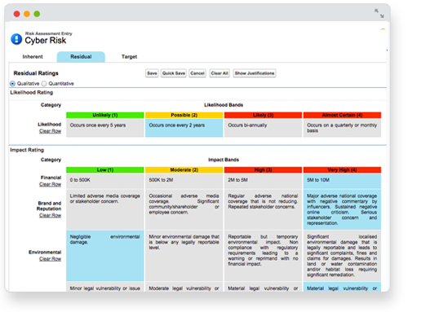
Systems – Risk, Xactium
Xactium is a Qualitative Risk Management Software.
It maintains risk registers in a collaborative environment
HS2 will grant access to their Xactium system to contractors.

Slide 20
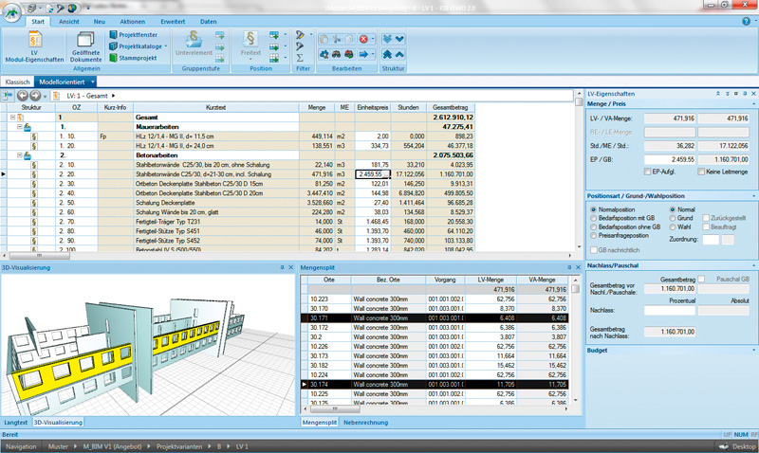
Systems – Cost Management, RIB iTwo
iTwo is an estimation/cost management software.
It has a very strong integration capabilities with Primavera
Capable of combining models from multiple sources
Integrates with finance packages
Has a mobile field data collection application

Slide 21
Systems – Cost Management, RIB iTwo
Scope Element | PRISM | CostOS | iTWO | Candy
Flexible, simple, powerful cost and resource modelling | R | A | G | R
Dynamic Bi-directional link to P6 (many-to-many) | A | A | G | G
Sub-contract adjudication and dynamic link of s/c BoQ/AS to strategic cost plan | R | A | G | A
Rail Method of Measurement enabled with rates database and change mgt | R | A | G | A
SQL database schema well understood and prototype reports developed | A | A | G | R
Integrated progress reporting based on quantities – Installed and Claimed | A | A | G | A
Multi-user and secure, implementation resource already trained | A | A | G | A
3D enabled and workflow enabled (for future possibilities) | A | G | G | A

Slide 22
Why Integration?
THE VALUE OF INTEGRATION
COST MODELLING, P6, WORK PACKAGE QUOTES, PROGRESS REPORTING, EARNED VALUE
PCM
Cost Engineer
Risk & Change
Reporting Manager
Cost Modeller
System Integrator
Cost/5D Modeller
Planning Manager
Planner
Cost Engineer
4D Simulator
ResourceModeller
SAVING: around £750k over course of 3 years

Slide 23
North Package Bid
Designed an Integrated Project Controls Architecture
Contributed to the responses of HS2 questions related to programme, risk, cost control, packaging and digital strategy
Created a test instance of the cost model for the Birmingham Spur section using iTwo.
We obtained permission from RIB to use iTwo at no additional cost for Fusion.
Integrated the cost model to Primavera
Produced a cost and resource loaded schedule
Generated several histograms for resources

Slide 24
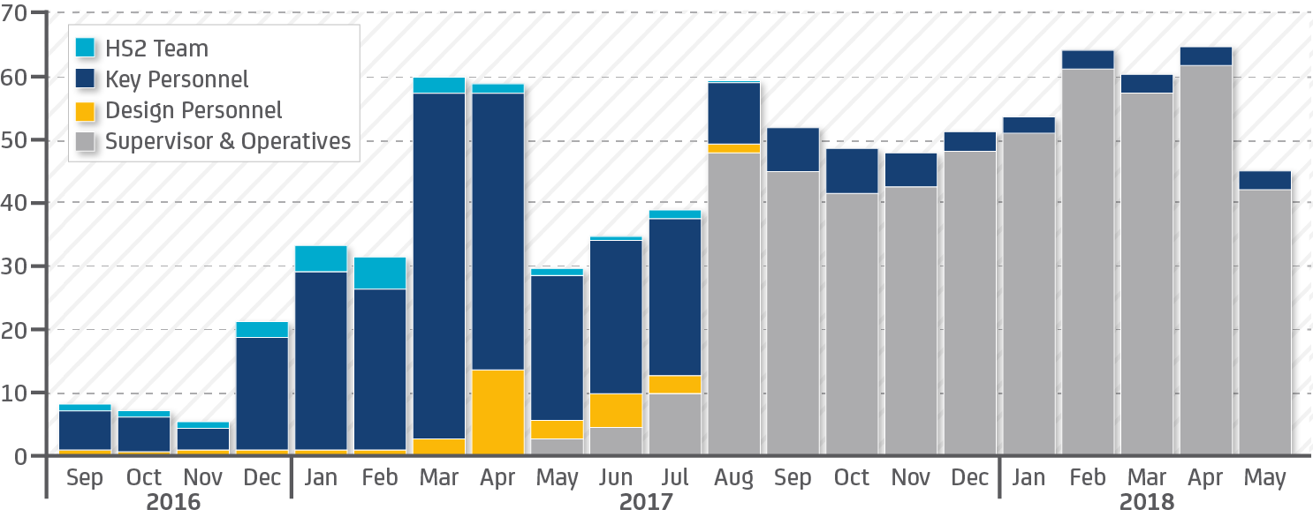
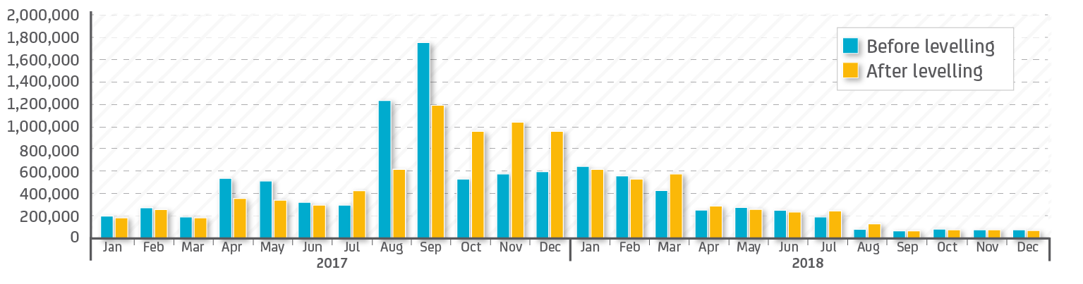
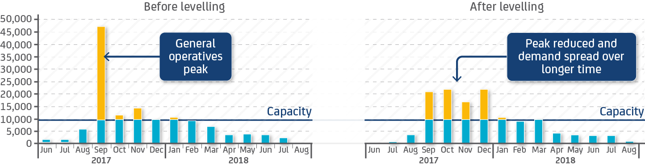
North Section - Outcomes

Slide 25
Central Enabling Works Bid
Central Enabling Works
In addition to the works achieved in the North bid:
We programmed a custom script to import all 4,000 activities to the cost model. (over 70% reduction in manual data handling)
Worked with the estimation team to improve estimation results
Generated a detailed schedule (4,600 activities) with cost, resource and logically linked
Produced manpower histograms and cash flow curves for the whole scope

Slide 26
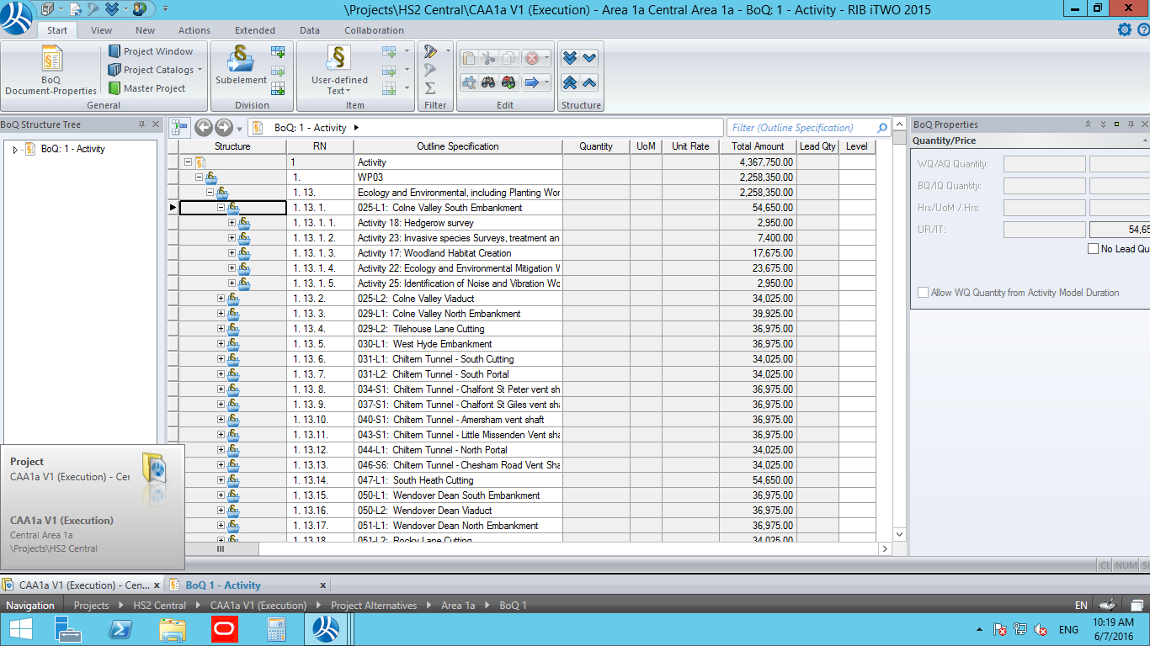
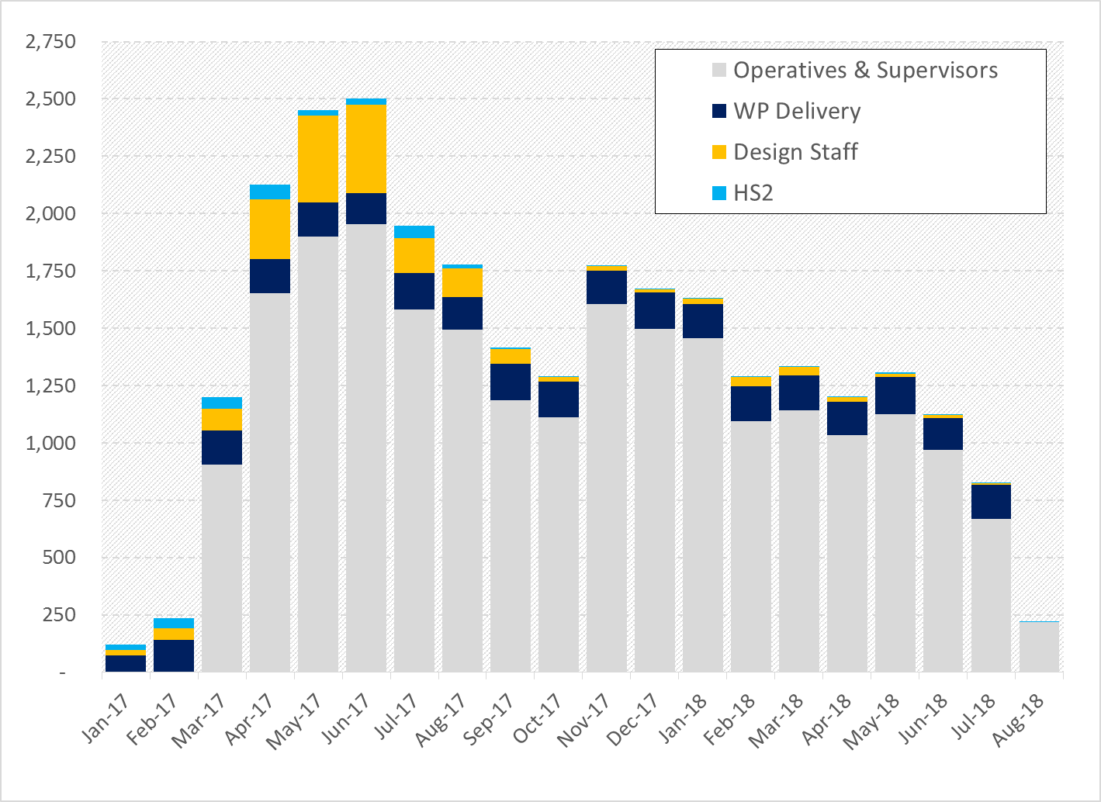
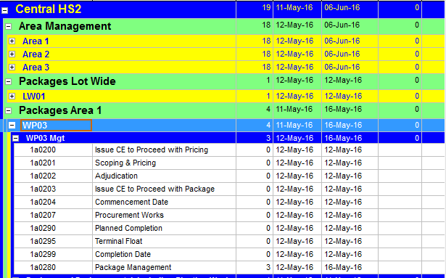
Central Model
Used Spreadsheet of 4,000 activities with out developed script
Produced a Cost Model reflection of packaging strategy and estimation data inputs.

Slide 27
South Enabling Works Bid
We did all works as achieved in North and Central and added the following:
In the south section we enhanced the cost model design to achieve better estimation outputs as well as performance
Designed a reporting dashboard that will be beneficial for progress monitoring
Categorised risk level for each activity
Contributed to the digital information strategy
Implemented an interactive dashboard that does data mining and visualisation

Slide 28
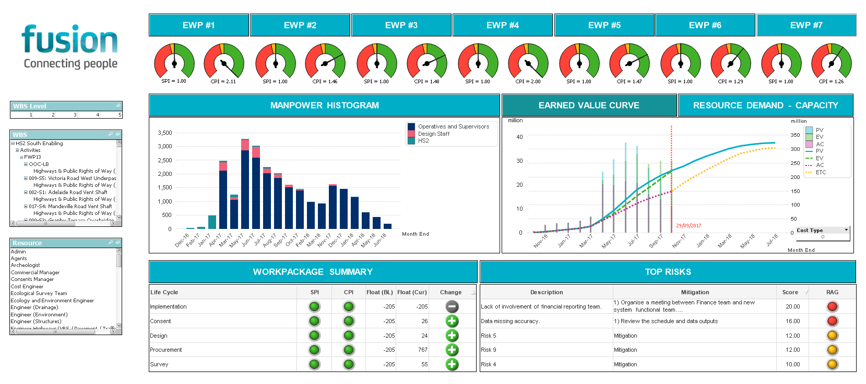
Reporting Dashboard Design & Implementation

Slide 29
Opportunities for Preparation Period
Prepare Project Controls Plans, Procedures, and Processes in compliance with WI.
Define data structure guidelines and manuals for Project Controls Systems and interfaces with other disciplines.
Design workflows for programme, cost, change, risk, and reporting
Design the required IT infrastructure to host systems
Identify required data by stakeholders to ensure they are captured in the reporting and within the data warehouses.
Finalise software selection and negotiate with vendors

Slide 30
Main Works Opportunities
Produce BIM related output such as 4D and 5D models with time-related clash detection functionality.
Design data structures, capturing and reporting system that integrates with project controls systems
Investigate further opportunities for integrating information of other disciplines such as HSE, Quality, Construction, Commercial
Defining a RACI matrix for the project
Strategy for exploiting data by applying world class techniques for data analytics
Implementing virtual reality (VR) to visualise design on the go.

Slide 31



VR IMPLEMETATION
Process
360 degree rendered images direct from the model
Benefits
No additional software
Mobile
Cost effective process
Quick turnaround (cloud processing)
Flexible
Smart Phone
Tablet
Desktop
Entrance Lobby
Chemo Bays

Slide 32
LogiKal Added Value
Support by highly competitive and trained resources in all aspects of project controls.
Systems analysis and design to optimise the project controls process and maximise the added value to Fusion and the Client.
Excellent relationships and partnerships with technology vendors.
Upskilling of suppliers by the structured training programmes.
Customised solutions to fit the business and differentiate Fusion from competitors during the bid.
Integration of Project Controls data with BIM
Maintained database for project information useful for benchmarking in future projects.

Slide 33
Thank You
Thank you
Question?

